Slide 1

Selenium UI Testing
Rick Hanton, SkyTouch Technology
Video of this presentation is at https://youtu.be/Y6OCWH29TdU

Slide 2

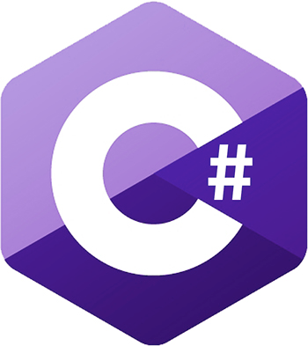







What is Selenium Webdriver?
Functional Automated Test Tool for Web Applications
Open source!
Supports Popular Languages:
Supports Popular Browsers:
Extensible, can use tools to run multiple tests at once

Slide 3

Selenium History
Jason Huggins and ThoughtWorks Inc. team developed it in 2004
They joked about HP Mercury Tools being an issue, so said you could “cure” the mercury problem using selenium supplements.
Original tool simply sent js commands to the browser.
Google was a big early user, where Simon Stewart created a project called WebDriver to solve limitations in the product.
Selenium & WebDriver merged in 2008 (Selenium 2.0), now separating somewhat

Slide 4
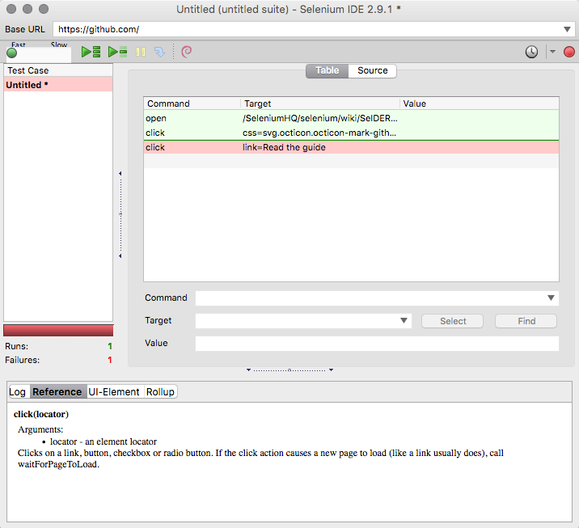
Two Parts
Selenium IDE
In-browser, non-coder friendly UI test automation engine
Firefox-only
Selenium WebDriver
Libraries for coding languages that use WebDriver to control browser
More maintainable, business-friendly

Slide 5
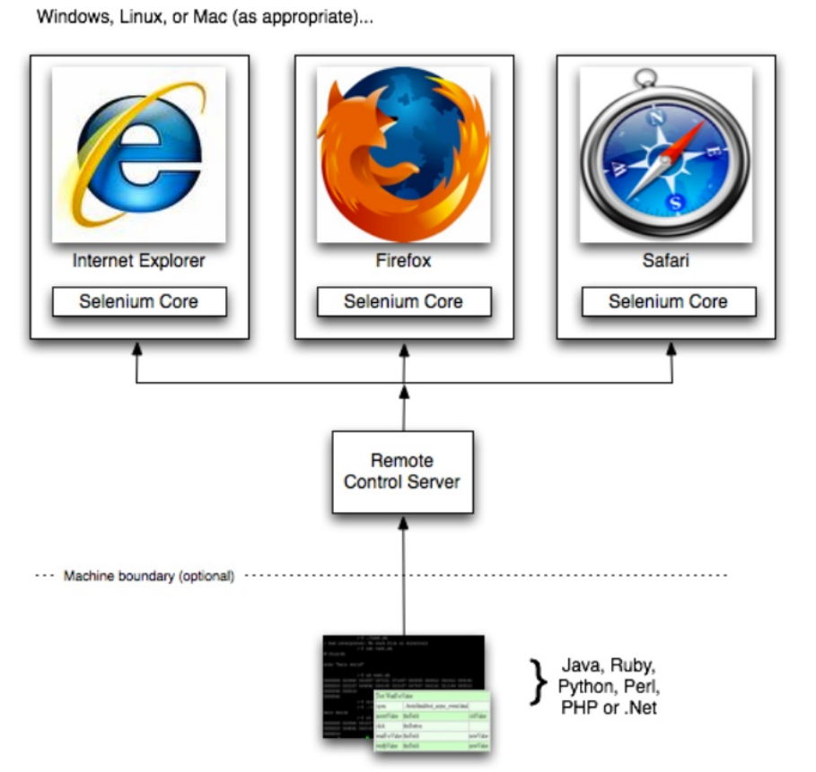
Selenium RC (Remote Control)

Slide 6
Good Selenium Design Principles
Use the page-object model to logically separate data, pages, services
Create robust reusable services that are called by test code
Create new state each time if possible, don’t assume current environment state will match the state the last time the test ran
Spend as little time possible creating preconditions
Structure code to support Selenium testing

Slide 7
Example time: Testing Steps
Go to reddit.com
Log in using credentials
Submit a specified new post (tester specified url, title, subreddit).
Search for the new post.
Verify title and url are correct.

Slide 8
Webdriver Demo
Code at https://github.com/hantonr/selenium-testng/

Slide 9
Why use Cucumber BDD?
Cucumber + Selenium allows for smart Behavior Driven Development progression
Can separate Selenium services written by devs from tests written by non-technical QA (more thorough testing = better)
English-language testing makes communication easy:
Story: Returns go to stock
As a store owner
In order to keep track of stock
I want to add items back to stock when they're returned.
Scenario 1: Refunded items should be returned to stock
Given that a customer previously bought a black sweater from me
And I have three black sweaters in stock.
When he returns the black sweater for a refund
Then I should have four black sweaters in stock.

Slide 10
Cucumber + Selenium Demo
Code at https://github.com/hantonr/selenium-cucumber/

Slide 11
Questions?

